Slide 1

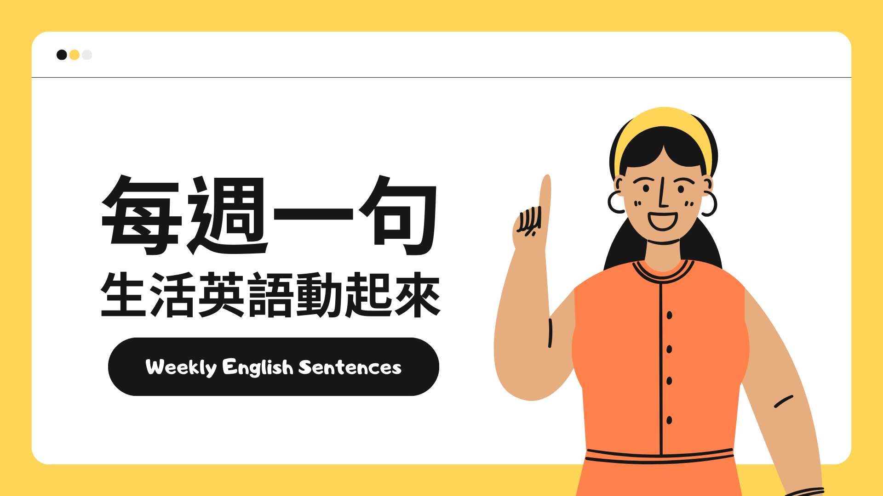
新北市二重國民小學 112學年度 兒童朝會
Er Chong Elementary School Morning Assembly

Slide 2
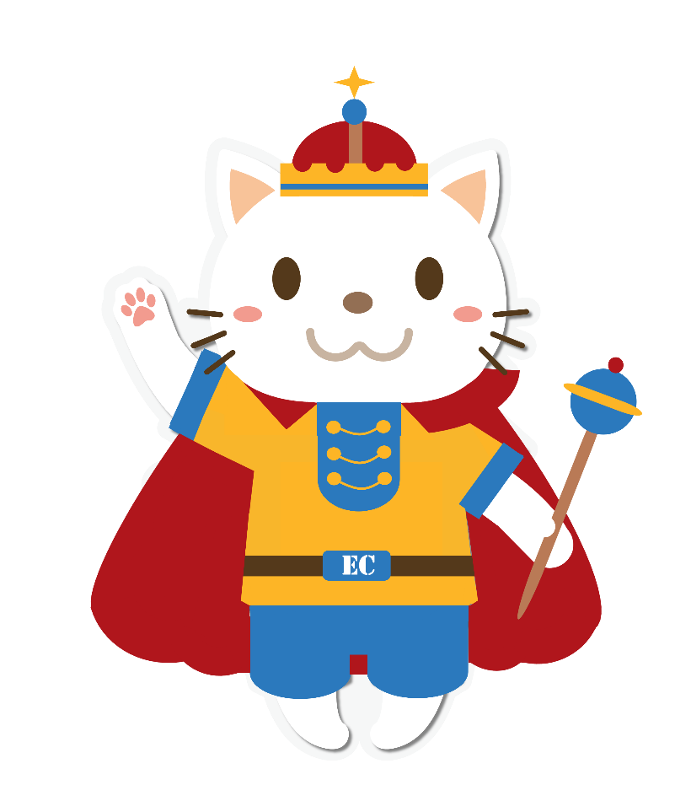
Mr. Steven： Good morning, girls！ What’s your name?
Girl 1~4： My name is …..
Mr. Steven： Wonderful! What do you do on Dragon Boat Festival?
Girl 1/2： We stand an egg and make sachets.
Mr. Steven: How about you?
Girl ¾： We eat rice dumplings and watch dragon boat race.
Mr. Steve： Excellent！ Thank you, girls！
Girl 1~4： Goodbye, Mr. Steven！

Slide 3
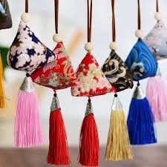
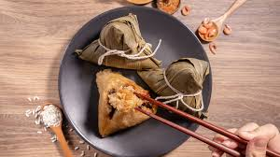
eat rice dumplings
make sachets

Slide 4
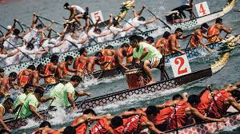
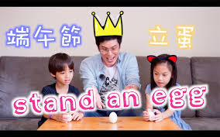
watch a dragon boat race
stand an egg

Slide 5



